Slide 1
SDSC 2005 - Introduction to Computational Social Science (Lecture 4)
Hao PENG
(haopeng@cityu.edu.hk)
Department of Data Science
City University of Hong Kong
https://haoopeng.github.io/

Slide 2
Agenda for today
Text preprocessing steps / tasks
NLP methods for sentiment analysis
Lexicon-based approaches (counting)
Machine learning (supervised)
Models: logistic regression, naïve bayes, etc.
Features:
Word-level: bag of words, n-grams, TF-IDF
Topic-level: LIWC (closed topics), LDA (open topics)
Homework 1 released after today
Due in four weeks!

Slide 3
Layers of text processing
Normalization (e.g. case conversion)
Tokenization / word-breaking ("what is a word?")
Spelling correction (if from interactive input)
Stopwords ("what is a useful word?")
Part-of-speech tagging (nouns, verbs, adjectives, adverbs, etc.)
Stemming ("what is an underlying word root?")
Named-entity recognition (“XYZ WU studied at CityUHK.")
Text mining in Computational Social Science:
Pattern detection (e.g., detect quotes in news articles)
Text classification (e.g., sentiment analysis, emotion, etc.)
Identify themes in text corpus (topic modeling; clustering)
etc.

Slide 4
Normalization
you probably know about this step:
don't forget to do this!
str.lower()
Remove social media specific elements
e.g., hashtags, mentions, URLs, emojis

Slide 5
Words and Tokens
The term word can be used in two different ways:
To refer to each occurrence of a word
To refer to a unique vocabulary item
For example, the sentence “my dog likes his dog” contains five occurrences of words, but four vocabulary words/items.
To avoid confusion, use more precise terminology:
Word token: a specific occurrence of a word
Word type: a vocabulary item

Slide 6
Tokenization
The simplest way to represent a text is with a single string.
Difficult to process large amounts of text in this format.
Often, it is more convenient to work with a list of tokens.
The task of converting a text from a single string to a list of tokens is known as tokenization.
What’s the (dis)advantage of tokenization?
Consider two pieces of text:
“The dwarf only jumps high and lands low.”
“Only the dwarf jumps low and lands high.”
How many word types? How many times does each word show up?

Slide 7
Tokenization
Sentence tokenization:
import nltk
text = "Hello, world. How are you, world?"
sent_text = nltk.sent_tokenize(text)
sent_text
Output: ['Hello, world.', 'How are you, world?']
Word tokenization:
sentence = "The quick brown fox jumped over the lazy dog!"
nltk.word_tokenize(sentence)
Output: ['The', 'quick', 'brown', 'fox', 'jumped', 'over', 'the', 'lazy', 'dog', '!']

Slide 8
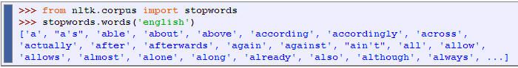
Lexical resources in NLTK
NLTK Package includes some corpora that are nothing more than wordlists (https://www.nltk.org/howto/corpus.html)
There is also a corpus of stopwords, that is, high-frequency words such as the, to, also that we often want to filter out before further processing a text/document.
Remove stopwords:
text = ”I don’t want to go to SDSC3013 today."
clean = ’ ’.join([w for w in text.lower().split() if w not in stopwords])

Slide 9
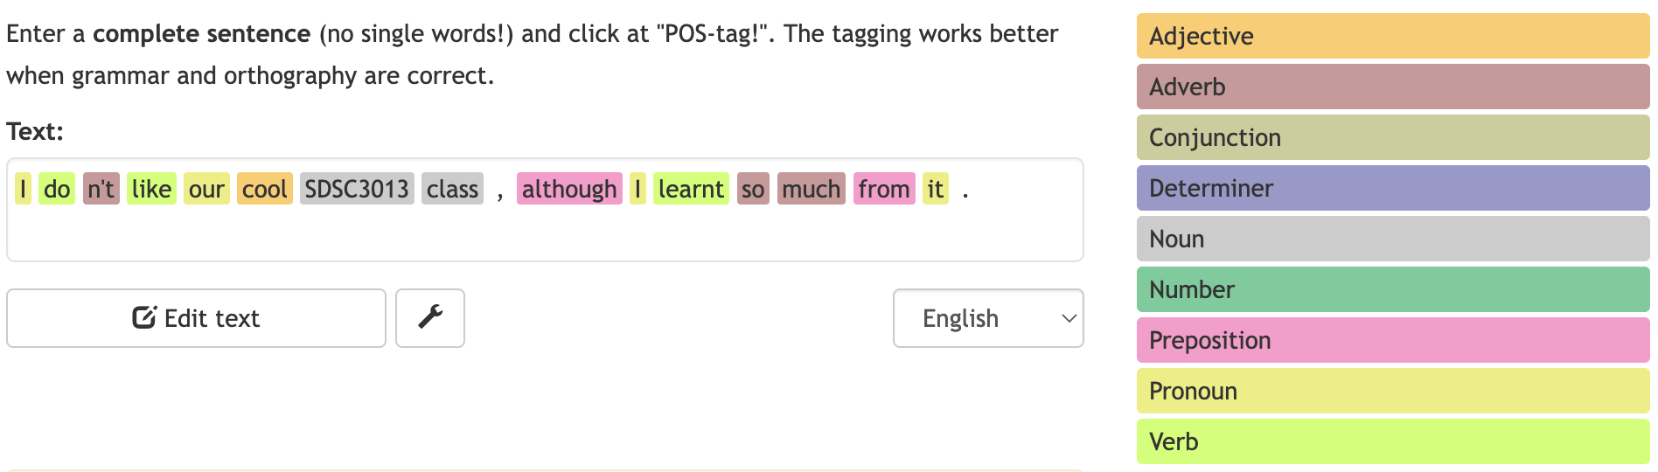
Part-of-speech tagging
Part of speech (POS) tagging is the automated process of assigning a grammatical category, or "part of speech," to each word in a text, such as a noun, verb, or adjective
There are various parts of speech categories, each with its own function in a sentence.
https://parts-of-speech.info/

Slide 10
Part-of-speech tagging
POS tagging in NLTK:
>>> sentence = "The quick brown fox jumped over the lazy dog!"
>>> tokens = nltk.word_tokenize(sentence)
>>> tags = nltk.pos_tag(tokens)
>>> tags
[('The', 'DT'),
('quick', 'JJ'),
('brown', 'NN'),
('fox', 'NN'),
('jumped', 'VBD'),
('over', 'IN'),
('the', 'DT'),
('lazy', 'JJ'),
('dog', 'NN'),
('!', '.')]

Slide 11
Named Entity Recognition: for detecting people, places, things …
NER in Python NLTK:
>>> sentence = "The quick brown fox spoke to Abraham Lincoln." >>> tokens = nltk.word_tokenize(sentence) >>> tagged_tokens = nltk.pos_tag(tokens)
>>> entities = nltk.chunk.ne_chunk(tagged_tokens)
>>> entities
Tree('S', [('The', 'DT'), ('quick', 'JJ'), ('brown', 'NN'), ('fox', 'NNS'), ('spoke', 'VBD'), ('to', 'TO'),
Tree('PERSON', [('Abraham', 'NNP'), ('Lincoln', 'NNP')]), ('.', '.')])

Slide 12
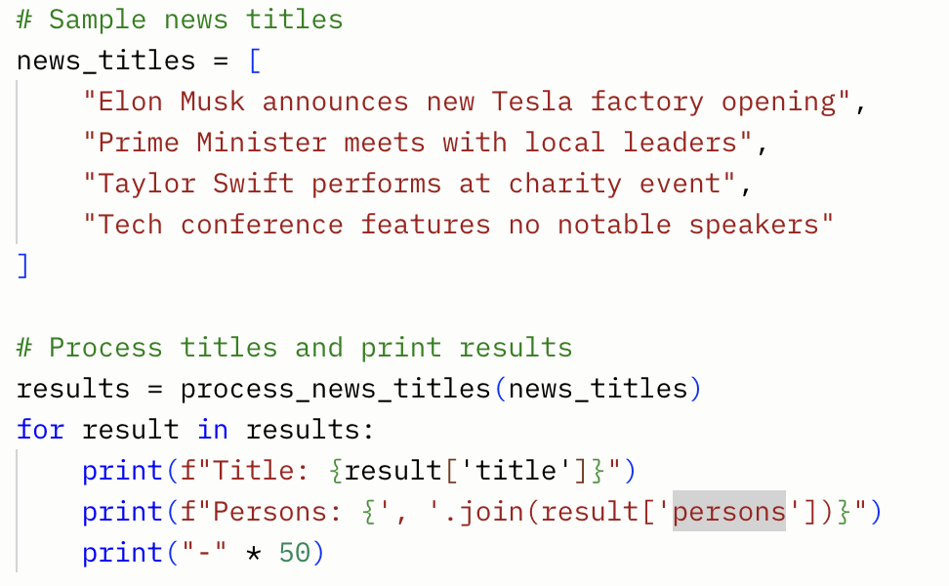
Q: How to identify famous people based on their news net worth?
Use NER to identify person entity in news titles.
Demo using Grok to help us write Python code.
Prompt: “Write python code to identify people in news titles.”

Slide 13
Stemming: merge diff. word forms
thinks → think
thinking → think thinker → think
argue → argu argument → argu
arguing → argu

Slide 14
WordNet Lemmatization
>>> from nltk.stem.wordnet import WordNetLemmatizer
>>> lmtzr = WordNetLemmatizer()
>>> lmtzr.lemmatize('cars')
'car'
>>> lmtzr.lemmatize('feet')
'foot'
>>> lmtzr.lemmatize('people')
'people'
>>> lmtzr.lemmatize('fantasized','v')
'fantasize'

Slide 15
WordNet Lemmatization
plurals = ['caresses', 'flies', 'dies', 'mules', 'denied',
... 'died', 'agreed', 'owned', 'humbled', 'sized’, 'meeting',
... 'stating', 'siezing', 'itemization', 'sensational',
... 'traditional', 'reference', 'colonizer', 'plotted']
>>> singles = [lmtzr.lemmatize(plural) for plural in plurals]
>>> print (' '.join(singles))
caress fly die mule denied died agreed owned humbled sized meeting stating siezing itemization sensational traditional reference colonizer plotted

Slide 16
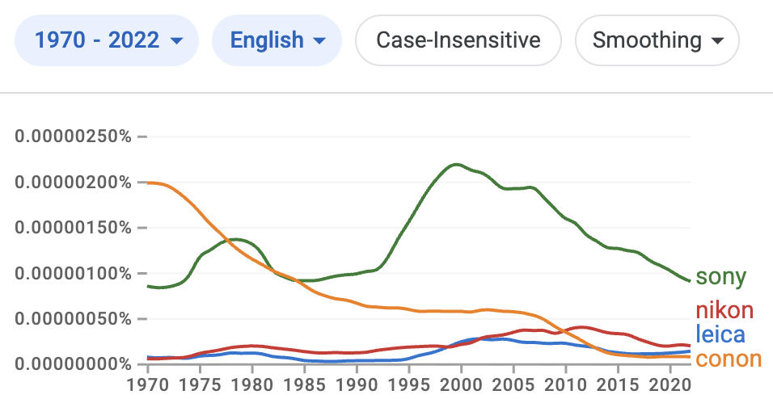
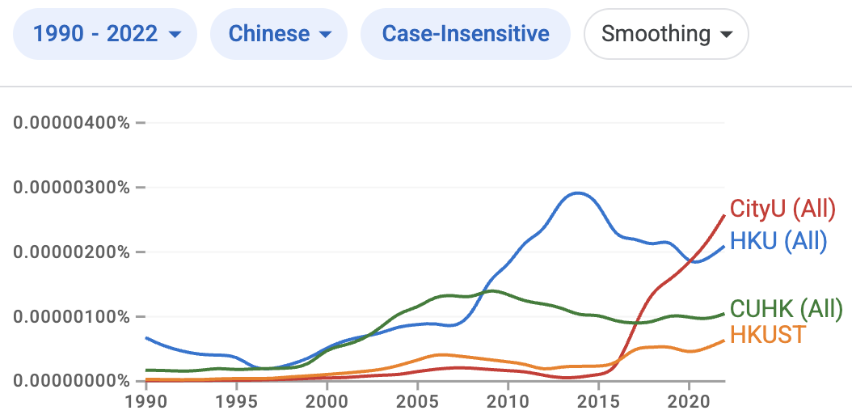
Google books: N-gram viewer
Check it out: https://books.google.com/ngrams
Popularity trends of camera brands / HK universities.
How does this compare to mentions on social media?

Slide 17
Text classification
Goal: Assign ‘objects’ from a universe to two or more classes or categories
Examples:
Tasks Object Categories
Tagging Word Part of Speech
Sense disambiguation Word The word’s senses
Information retrieval Document Relevant/not relevant
Named entity recognition Document People/location/…
Sentiment classification Document Positive/negative/…
News classification Document Sport/science/finance…
……

Slide 18
Sentiment Analysis
Attempt to identify affective state of text with NLP methods.
How do we measure sentiment (score or category)?
At what level? Word or sentence?

Slide 19
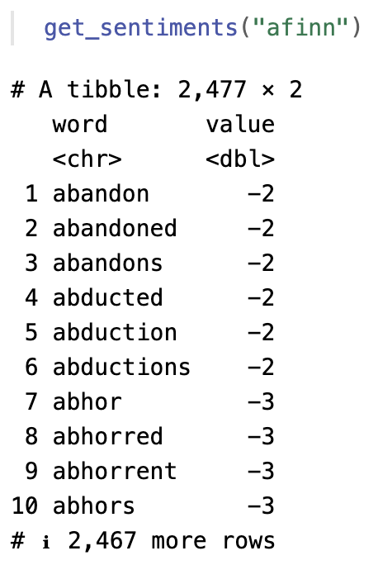
Sentiment Analysis
Lexicon-based approach
Lexicon: each word is assigned a sentiment score.
Sum sentiment score of all words in the given text.
Challenge: which words are associated with positive/negative sentiment?
Weaknesses:
Manual annotation
Can be very subjective / imprecise
Does not consider the word’s context
Ignores word phrases

Slide 20
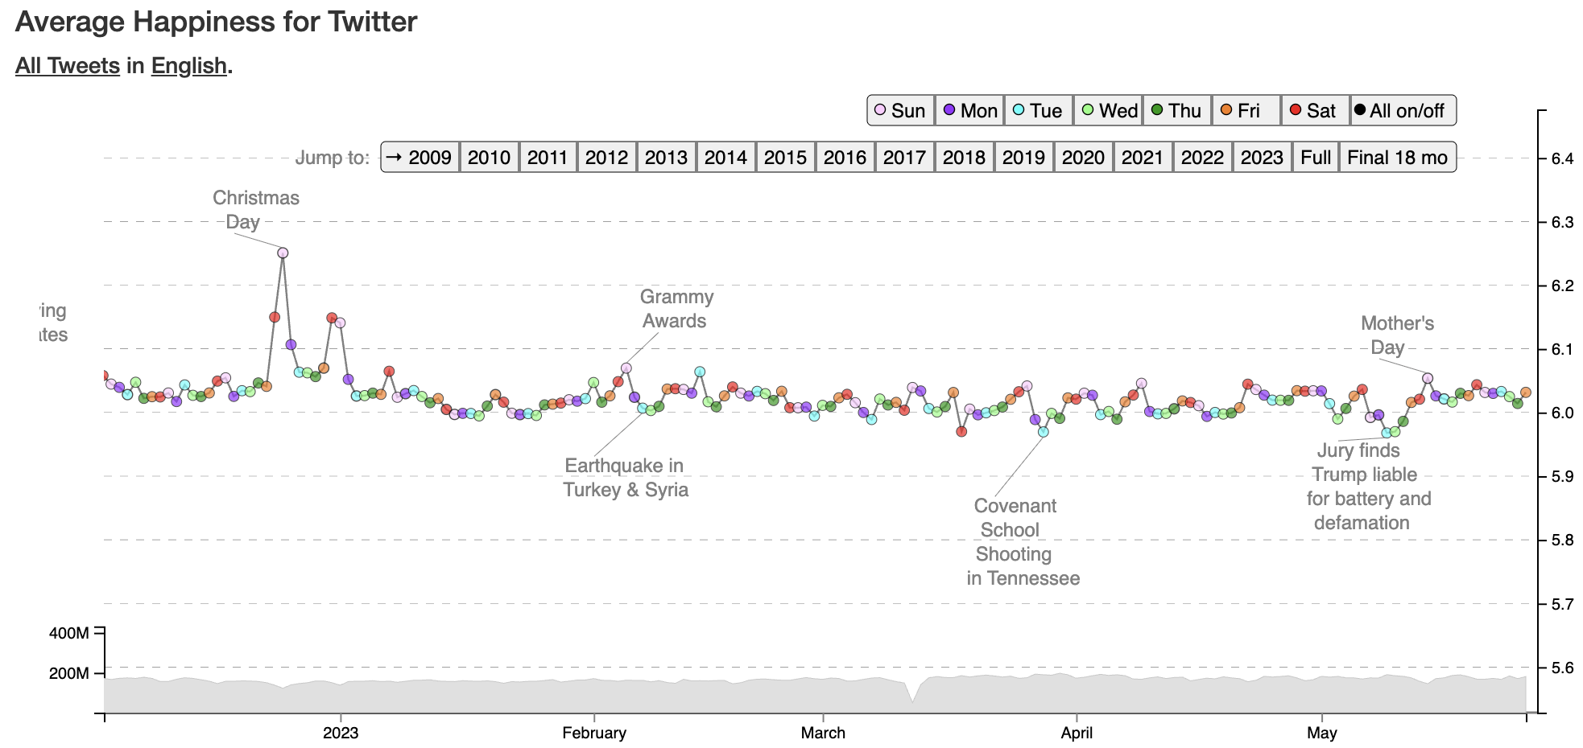
Demo: Hedonometer of happiness
https://hedonometer.org/timeseries/en_all/?from=2022-12-03&to=2023-05-26&viz=wordshift

Slide 21
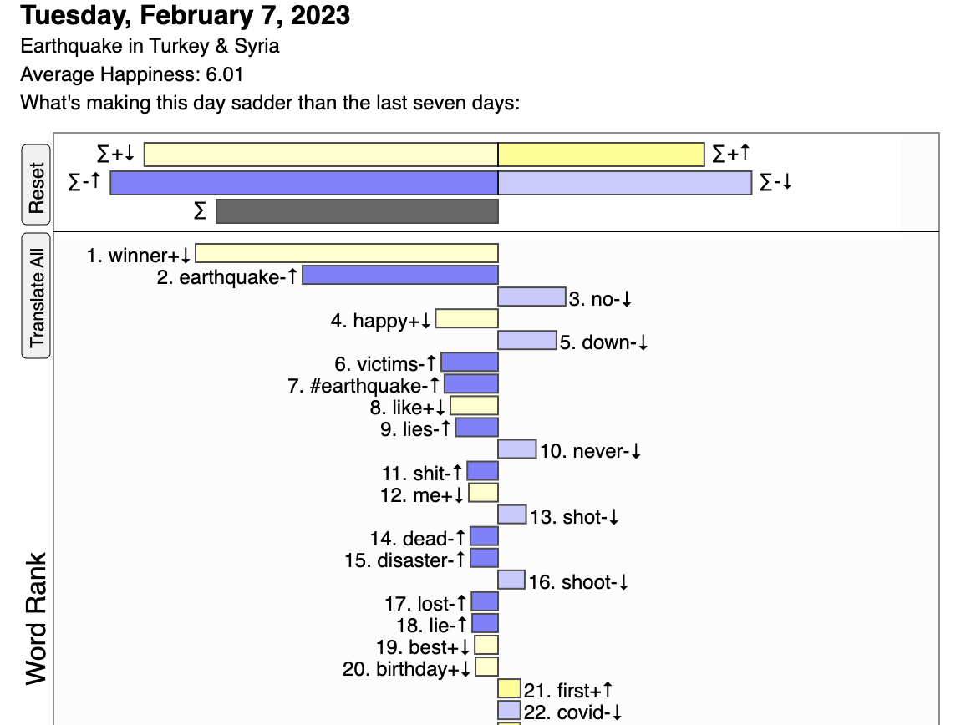
Measure happiness via word change

Slide 22
Sentiment Analysis
Lexicon-based approach with pre-defined rules
E.g., VADER (Valence Aware Dictionary and sEntiment Reasoner)
https://github.com/cjhutto/vaderSentiment (Incorporated in NLTK!)
Utilizes a pre-defined lexicon of words, each with a sentiment score (valence)
Incorporates a set of rules to account for linguistic nuances:
Punctuation: Exclamation points can amplify sentiment.
Capitalization: All-caps can indicate increased intensity.
Degree Modifiers: Words like "very" or "slightly" modify sentiment intensity.
Negation: Words like "not" or "never" reverse words’ sentiment.
Conjunctions: "But" can shift the focus and sentiment within a sentence.
Other tools:
sentimentr: https://github.com/trinker/sentiment

Slide 23
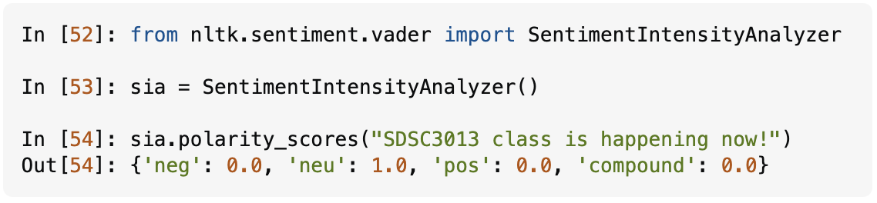
Sentiment Analysis
Strengths of VADER:
Optimized for social media language (e.g., informal, emojis, slang)
No need of training data (labeled text is expensive/rare)
Provides a more nuanced analysis than simple word counting

Slide 24
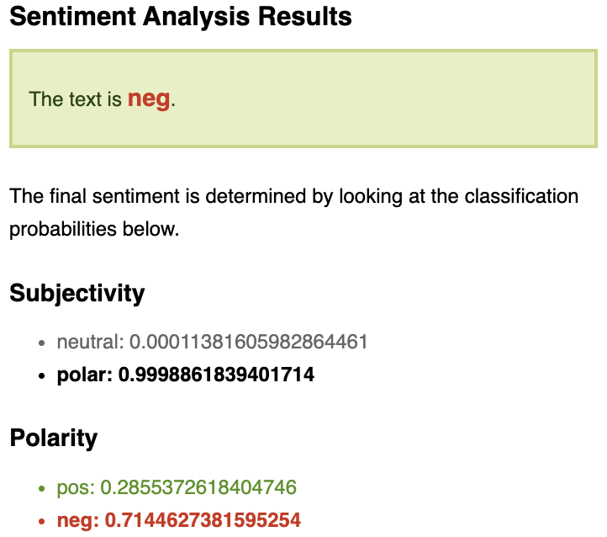

Limitations of lexicon approaches
Difficult to evaluate mixed-sentiment sentences.
e.g. Your essay’s introduction is good, but the conclusions are weak.
Hard to deal with words with multiple meanings.
I am not going to miss you.
I am not going to miss using this product.
Sentiment prediction is domain-specific and context-dependent!

Slide 25
Sentiment Analysis
Machine learning based approach
Training data is needed
texts (X) with human-annotated sentiment labels (y)
Feature engineering
Bag of words, n-grams
Theme / Topic of words
Word embeddings
Model evaluation
AUC-ROC
F1-score
(more on this next week!)

Slide 26
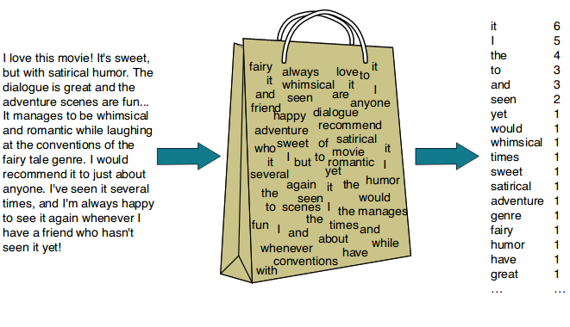
Bag of words
Do text pre-processing first
Count word frequencies for each document
Represent each document as a numerical vector
https://koushik1102.medium.com/nlp-bag-of-words-and-tf-idf-explained-fd1f49dce7c4
Notes:
Advantages and disadvantages?

Slide 27
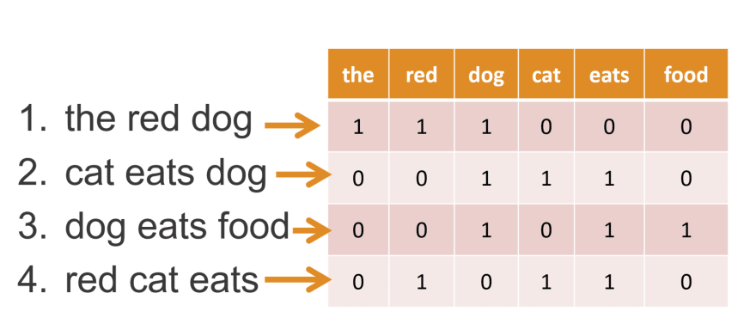
Bag of words
Easy to understand, explain, and implement
Scalable to a large collection of documents
Generalize to many NLP tasks
Document similarity
Text classification
Text clustering
Disadvantages?
https://aiml.com/what-are-the-advantages-and-disadvantages-of-bag-of-words-model/

Slide 28
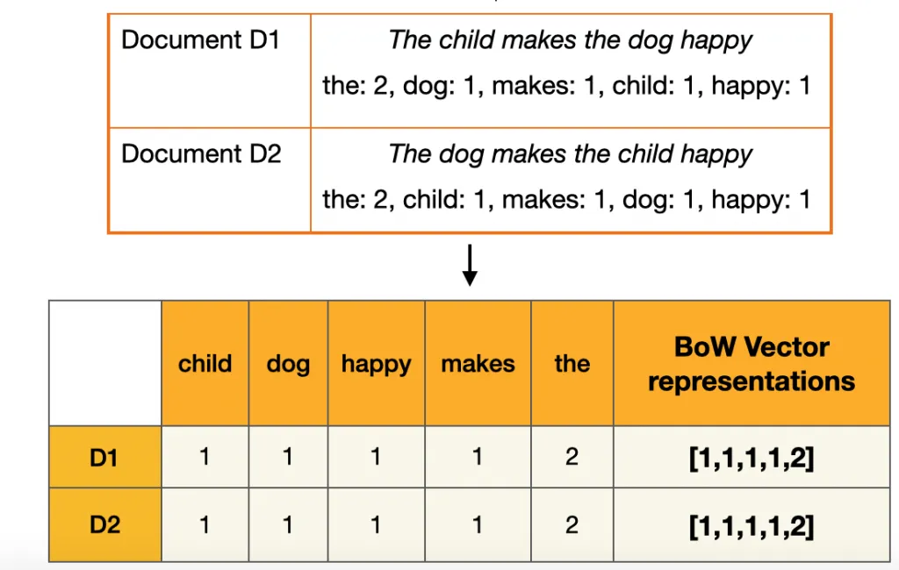
Bag of words weakness
Cannot handle out-of-vocabulary words
Sparse matrix is very inefficient
All words are equally important
Word order is lost

Slide 29
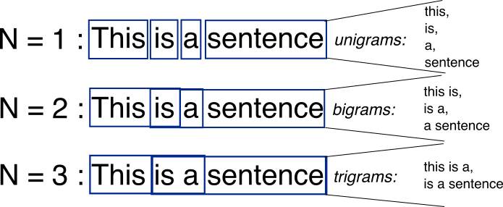
N-grams
Can capture word context (to some degree)
Significant increase in the model’s vocabulary size
Can use highly frequent phrases to reduce complexity
https://www.kaggle.com/code/samuelcortinhas/nlp3-bag-of-words-and-similarity

Slide 30
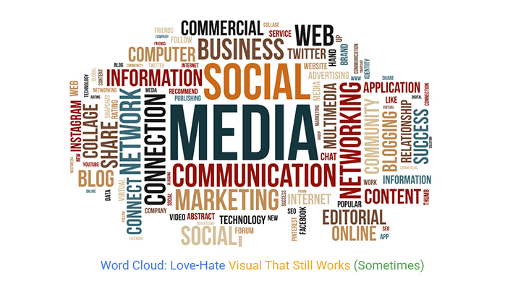
Not all words are equal
Notes:
Stopwords would occur very frequently in every document, which affects cosine similarity.

Slide 31
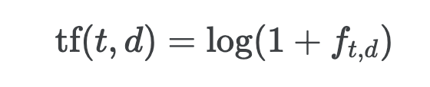
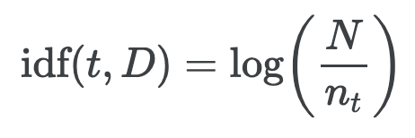
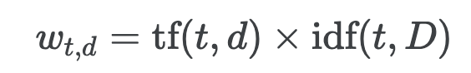
TF-IDF
Term Frequency: how many times a word appears in a text.
Inverse Document Frequency: how rare a word is across corpus.
TF-IDF: TF x IDF assigns a weight to each word, which reflects its importance within the text and its uniqueness across the corpus.
Common steps: text preprocessing; represent texts as vectors; each word is a dimension, with the TF-IDF scores as its values.

Slide 32
Sentiment analysis with TF-IDF
Build the same machine learning pipeline:
Obtain labeled data (supervised learning)
Feature engineering / transformation
Text preprocessing
TF-IDF vectorizing
Model comparison / evaluation
Logit, Naive Bayes, etc.
AUC-ROC
F1-score

Slide 33
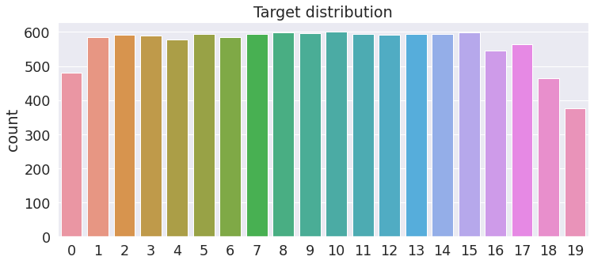
News classification (TF-IDF)
# nlp core
import spacy
# sklearn
from sklearn.datasets import fetch_20newsgroups
from sklearn.feature_extraction.text import CountVectorizer, TfidfVectorizer
from sklearn.metrics import f1_score, classification_report
from sklearn.naive_bayes import MultinomialNB
# Fetch data
train = fetch_20newsgroups(subset='train', remove=('headers', 'footers', 'quotes’))
test = fetch_20newsgroups(subset='test', remove=('headers', 'footers', 'quotes'))

Slide 34
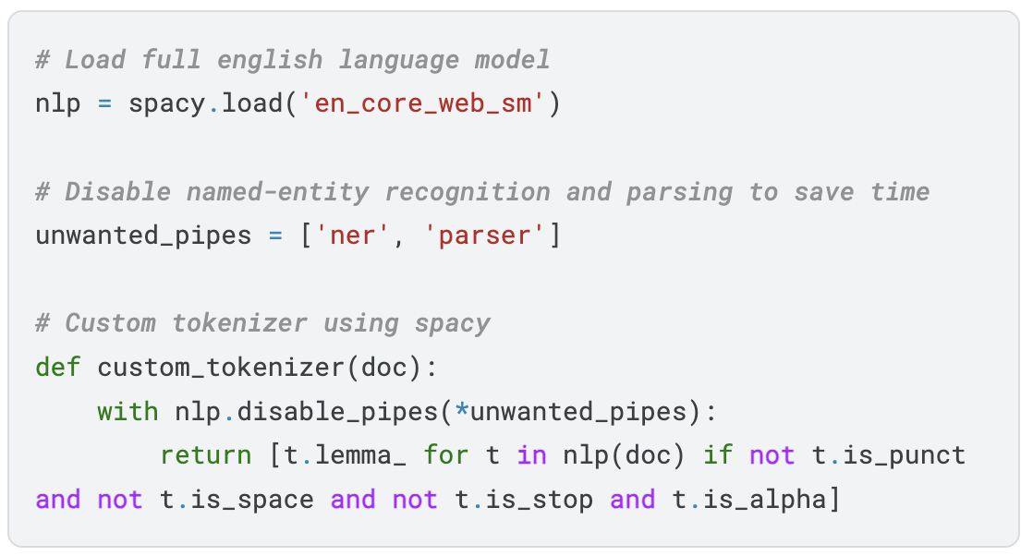
News classification (TF-IDF)
https://www.kaggle.com/code/samuelcortinhas/nlp5-text-classification-with-naive-bayes
Notes:
Removes punctuation, spaces, stopwords, and numbers.
Add lemmatization
Skip NER and Parsing

Slide 35
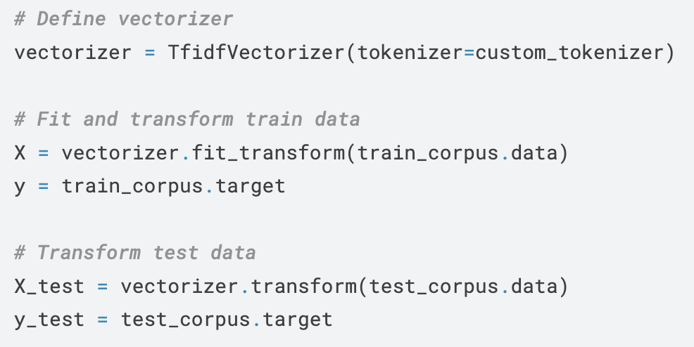
News classification (TF-IDF)
clf = MultinomialNB() # can change it to logit model
clf.fit(X, y)
test_preds = clf.predict(X_test)
print('Test set F1-score:', f1_score(y_test, test_preds, average='macro'))
Notes:
Removes punctuation, spaces, stopwords, and numbers.
Add lemmatization
Skip NER and Parsing

Slide 36
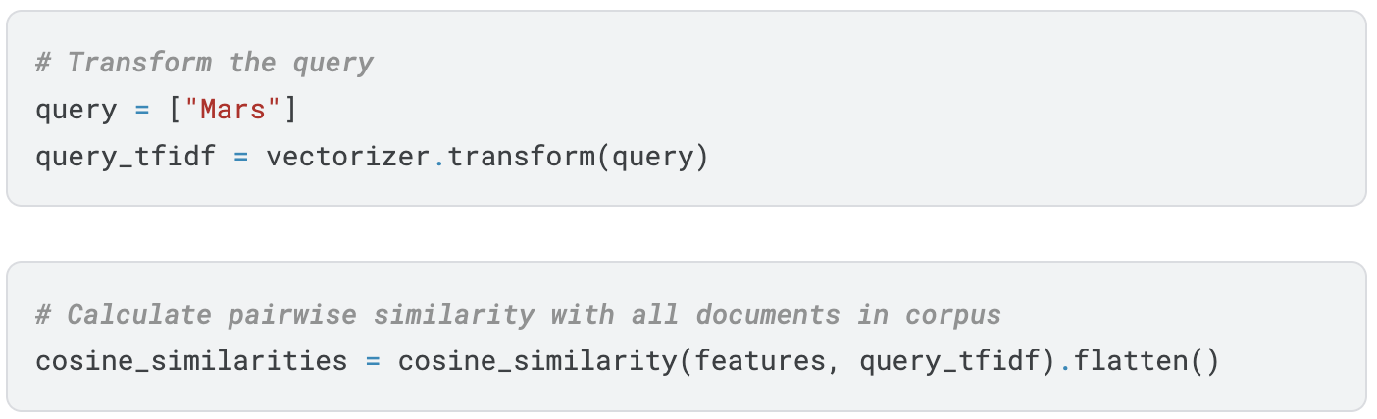
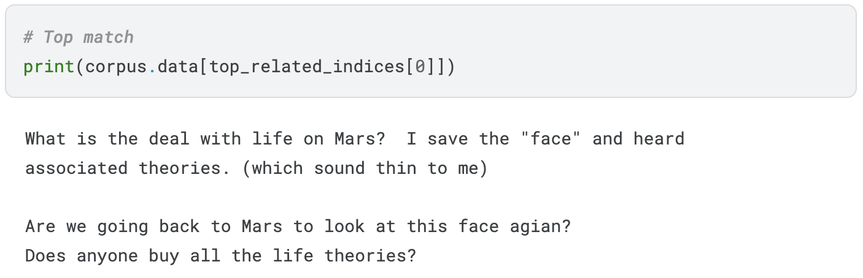
Document search with TF-IDF
# Transform all textual data into TF-IDF representation
features = vectorizer.transform(doc_corpus)
https://www.kaggle.com/code/samuelcortinhas/nlp4-tf-idf-and-document-search

Slide 37
Complex text analysis / prediction
Emotion classification
Spam/clickbait detection
Helpfulness rating on Q&A sites
Complain/fake/rating of product reviews
Civility/toxicity/hateful speech
Language identification of posts
Fake news / bot detection
Identify AIGC posts on RedNote
Need advanced methods to deal with complex linguistic tasks.

Slide 38
Higher level features
Word-level:
Bag of words, N-grams
TF-IDF
Topic-level:
LIWC
LDA
Embeddings:
Word2vec
Contextual embeddings

Slide 39
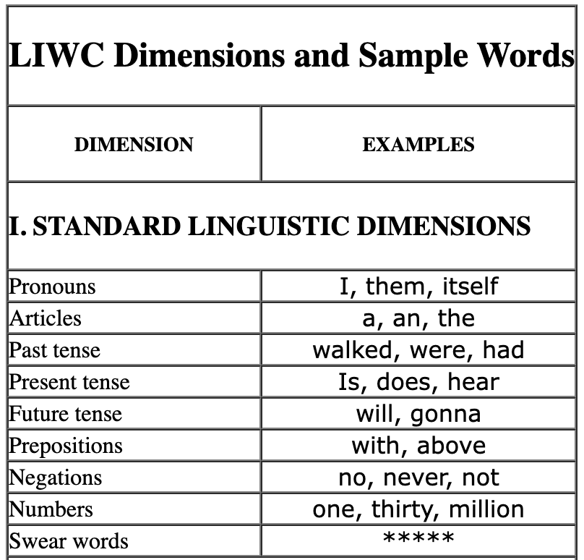
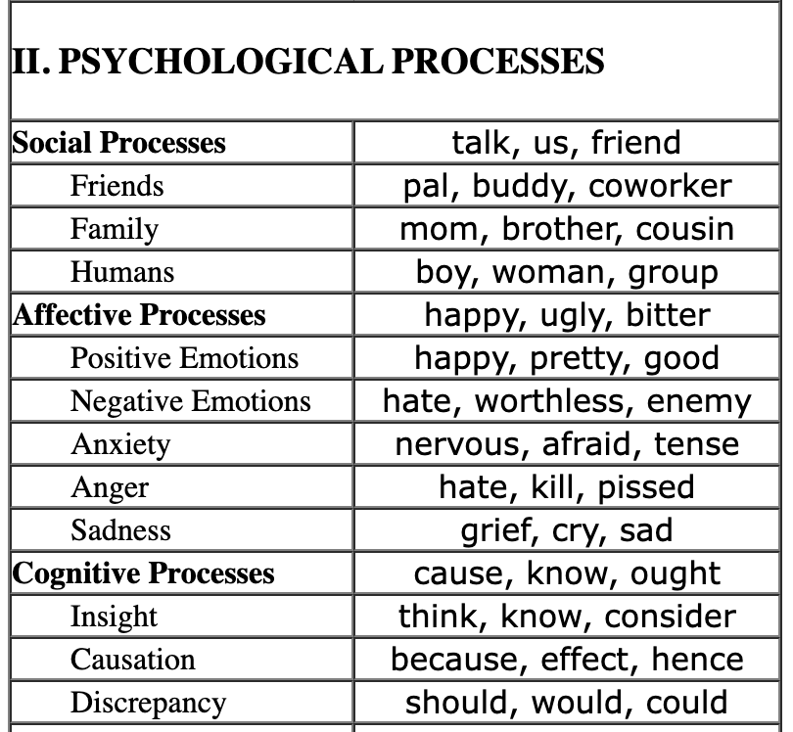
LIWC word-topic dictionary
Linguistic Inquiry and Word Count (LIWC)
Closed-vocabulary: fixed word dictionary look up
Feature engineering: aggregate word count into topic count
https://lit.eecs.umich.edu/geoliwc/liwc_dictionary.html

Slide 40
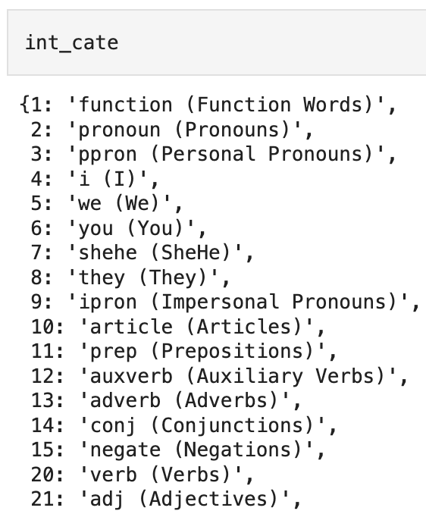
LIWC in python demo
with open('./LIWC.pkl', 'rb') as liwc:
int_cate, liwc = pickle.load(liwc)
print(liwc)
{'dormancy': [110, 112],
'bronchiarctia': [70, 72],
'naggy': [30, 32, 34],
'disorientates': [50, 54],
'daywrit': [100, 103],
'gentlewomanish': [40, 43],
'fifty': [24],
'undeterminable': [50, 54],
'accomplishment': [80, 82, 110], …}

Slide 41
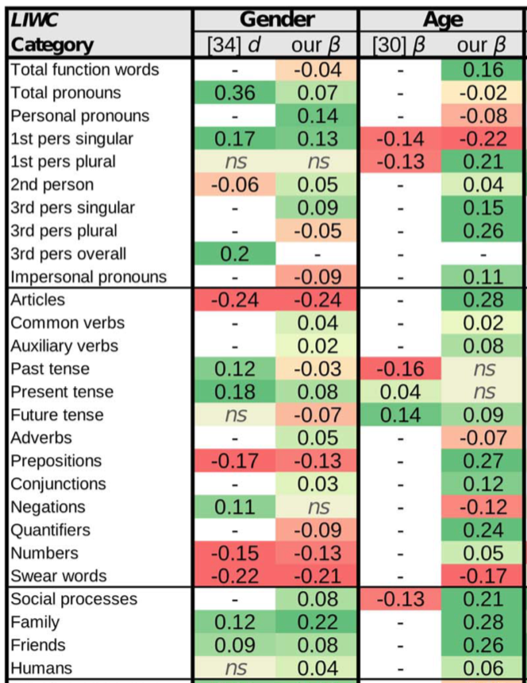
LIWC in predicting gender & age
Advantages of LIWC? Any disadvantages?
https://doi.org/10.1371/journal.pone.0073791
Notes:
Insensitivity to Context and Negation: As a "bag-of-words" system, LIWC often misses the context of a sentence, including irony, sarcasm, and negation. For example, it might count "not happy" as a positive emotion because it detects the word "happy" but not the negation "not".
Limited Domain Adaptability: The default LIWC dictionaries may not adequately cover jargon, slang, or specialized vocabulary in specific fields, such as software engineering, technical reports, or niche social media platforms.
Overlapping Categories: Some LIWC categories overlap (e.g., "social" and "affective" words), which can complicate the interpretation of results.

Slide 42
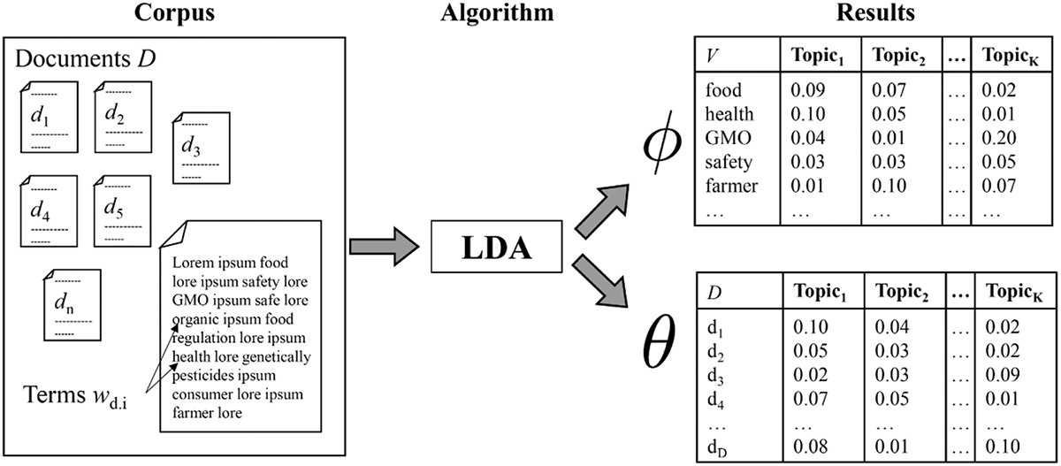
LDA topic modeling
Latent Dirichlet Allocation (LDA) is a generative statistical model for automatically discovering hidden topics across a set of documents (Unsupervised learning; Open-vocabulary approach)
Represent documents as prob. distribution of topics
Represent the topics are prob. distributions of words
https://doi.org/10.1080/19312458.2018.1430754

Slide 43
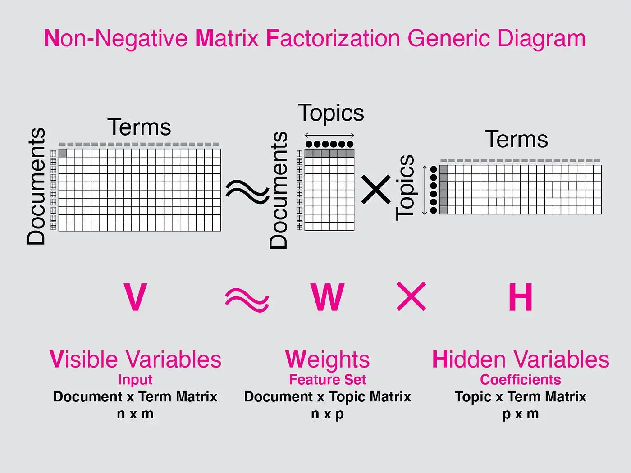
LDA topic modeling
LDA is similar with PCA. They both are matrix factorization techniques.
LDA is applied to text data. It works by decomposing the Document Word Matrix (the larger matrix) into two parts (smaller matrices): the Document Topic Matrix and the Topic Word Matrix.
Notes:
Topics matrix is the PC scores
Terms matrix is the PC loadings

Slide 44
Applications of LDA
LDA can transform data into low dimensional feature space
Perform predictive tasks using the document-topic matrix:
categorize news (sports, politics, tech, etc.)
book / music / movie genre classification
recommendation system; document search
predict user age, gender, ethnicity, sentiment, etc.

Slide 45
Identify topics in song lyrics
import spacy
from gensim import models, corpora
# Fetch data
songs_df = pd.read_csv("https://www.kaggle.com/datasets/notshrirang/spotify-million-song-dataset.csv")
data = list(songs_df["text"]) # clean the data
tokenized_data = list(map(custom_tokenizer, nlp.pipe(clean_data, n_process=4)))
# Build dictionary of (token, ID) mappings, Filter tokens
dct = corpora.Dictionary(tokenized_data)
dct.filter_extremes(no_below=5, no_above=0.5)
# Build Bag-of-Words sparse matrix
bow = [dct.doc2bow(i) for i in tokenized_data]
# Train LDA model
lda_model = models.LdaModel(corpus=bow, num_topics=10, passes=10, alpha='auto', eta='auto', id2word=dct)
https://www.kaggle.com/code/samuelcortinhas/nlp6-topic-modelling-with-lda
Notes:
tokenized_data could be [["cat", "dog", "pet"], ["dog", "bark", "pet"], ["cat", "meow"]].
bow is a list of lists, where each inner list is a BoW representation of a document, e.g., [[(0, 2), (1, 1)], [(2, 1), (3, 3)]].
(word with ID 0 appears twice, word with ID 1 appears once, etc.)

Slide 46
Song recommendations with LDA
# Get word distribution for each topic
topic_words = lda_model.show_topic(topic_id)
# Return topic distribution for a given bow as a list of (topic_id, prob) tuples.
# Note: Probabilities sum to ~1.
topics = lda_model.get_document_topics(bow[song_idx])
# Get topic distributions of new documents.
new_songs = ["Demons on my shoulder Monsters in my head”, “Shadow in the water Will you be my friend”]
new_tokens = list(map(custom_tokenizer, [nlp(new_songs)]))
new_bow = dct.doc2bow(new_tokens)
new_topic_vectors = lda_model[new_bow]
# Get topic distributions for the training corpus.
topic_vectors = lda_model[bow]
# Compute consine similarities
def to_dense_vector(sparse_dist, num_topics):
dense = np.zeros(num_topics)
dense[[i for i, p in sparse_dist]] = [p for i, p in sparse_dist]
return dense
https://www.kaggle.com/code/samuelcortinhas/nlp6-topic-modelling-with-lda
Notes:
print("Corpus topics:", new_topic_vectors) # Example output: [[(0, 0.69), (1, 0.30)], [(2, 0.20), (5, 0.78)]]

Slide 47
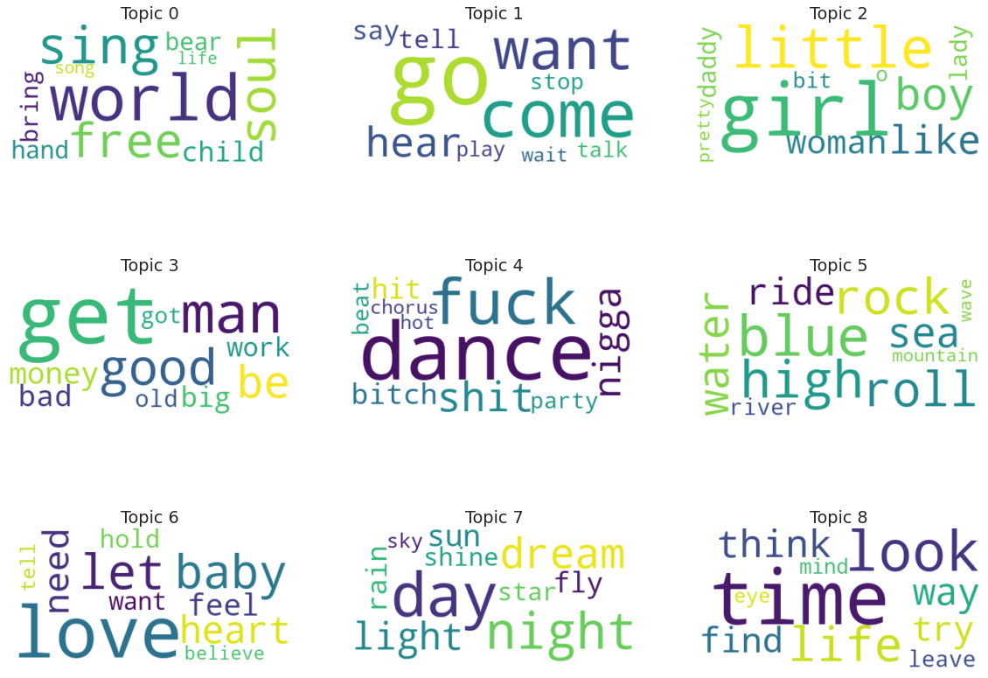
Visualizing topics

Slide 48
Limitations of LDA
Doesn’t work well on short document (such as Tweets).
LDA relies on the assumption that words in each topic are related and meaningful, but this may not always be the case.
It can produce ambiguous or incoherent topics.
Not straightforward to evaluate topics’ quality.

Slide 49
Other text classification tasks
Spam/clickbait detection
Helpfulness rating on Q&A sites
Complain/fake/rating of reviews
Civility/toxicity/hateful speech
Language identification of posts
Fake news / bot detection
Identify AIGC posts on RedNote

Slide 50
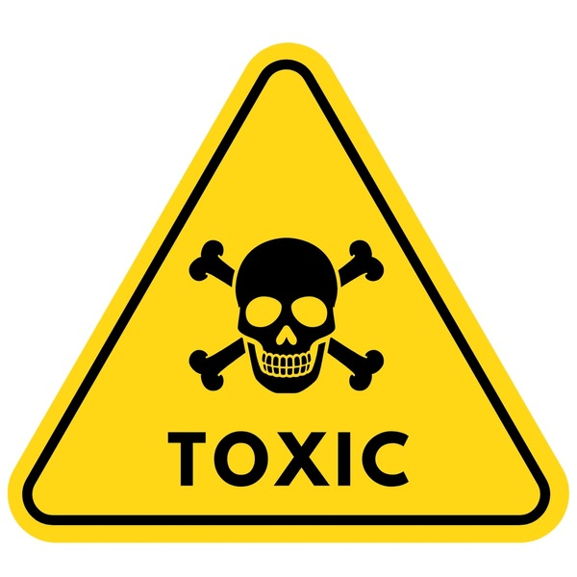
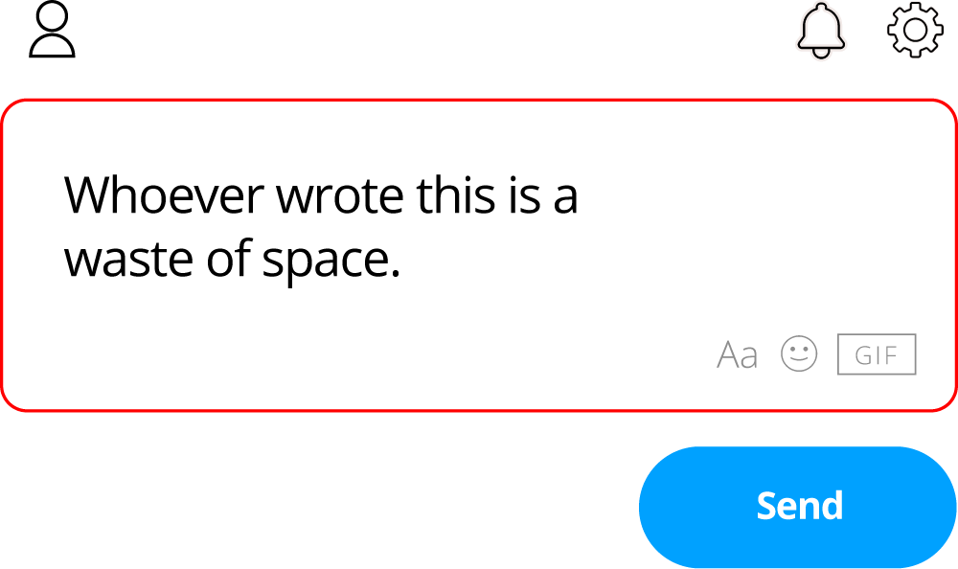
Toxicity prediction
Good for content moderation for online platforms
Help to maintain healthy / civic conversations
Prevent online abuse and harassment

Slide 51
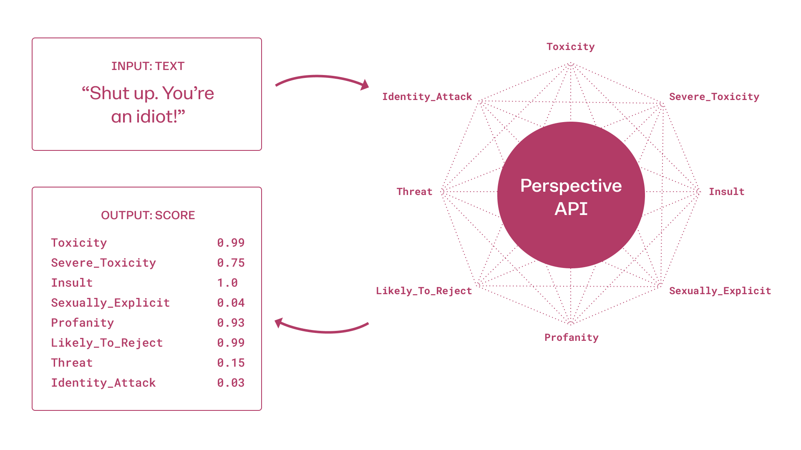
Perspective API by Google
Python library:
https://developers.perspectiveapi.com/s/docs-sample-requests
Other Github package:
https://github.com/baishalidutta/Comments-Toxicity-Detection

Slide 52
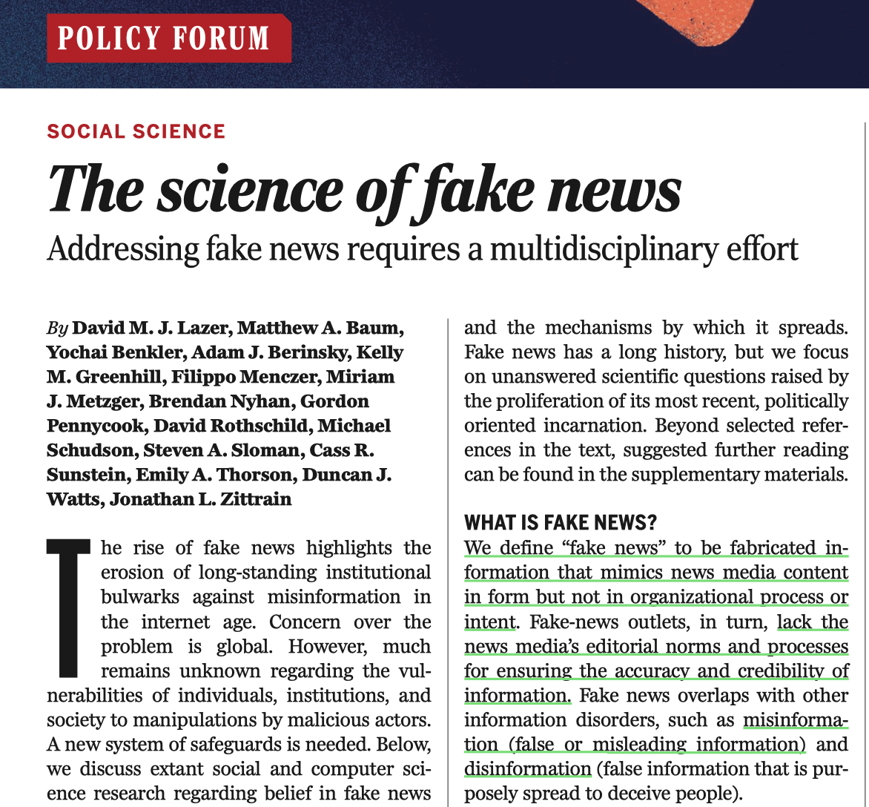
Lazer et al. 2018, Science

Slide 53
Fake news
Definition:
Purposefully crafted, sensational, emotionally charged, misleading or totally fabricated information that mimics the form of mainstream news (Zimdars & McLeod, 2020).
Three varieties:
Disinformation: Content that is intentionally false and designed to deceive people and cause harm.
Misinformation: Misleading content but the person sharing doesn’t realize that it is false or misleading.
Malinformation: Genuine information that is shared out of context with an intent to cause harm.

Slide 54
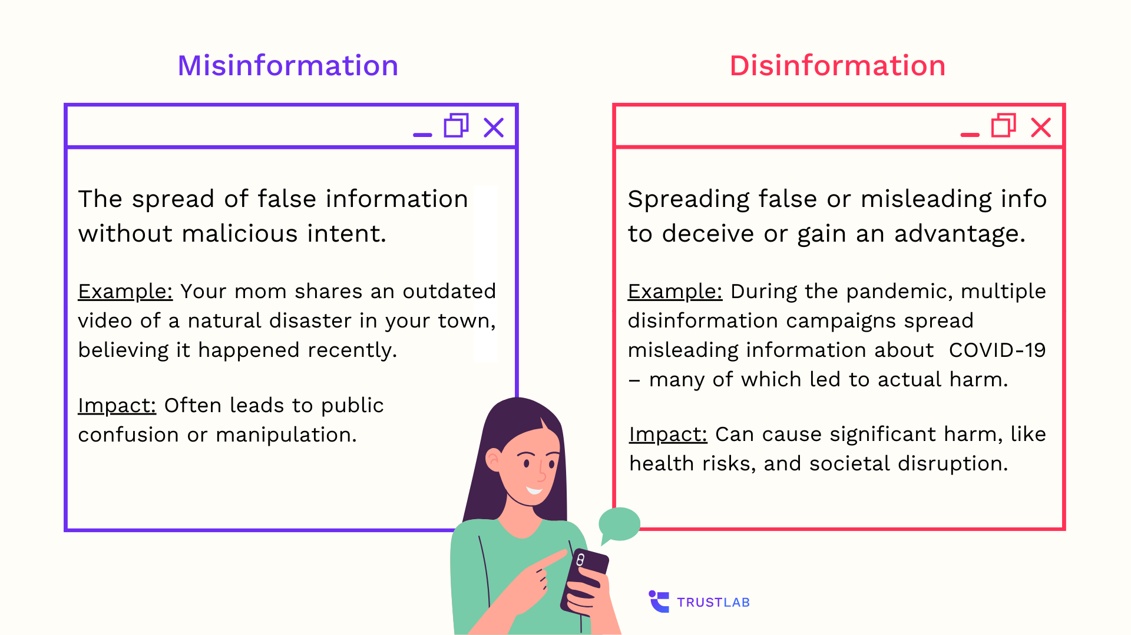
Fake news
Notes:
Question mark graphic, Week 2 preview.

Slide 55
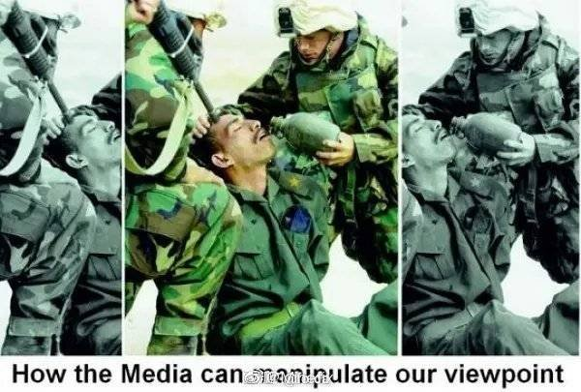
Fake news example
Soldiers saving lives or killing people?
Notes:
Question mark graphic, Week 2 preview.

Slide 56
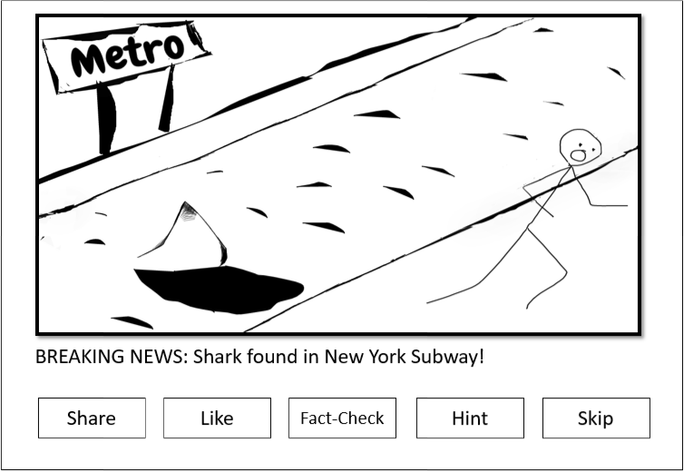
Fakey game
Play the game: https://fakey.osome.iu.edu/login

Slide 57
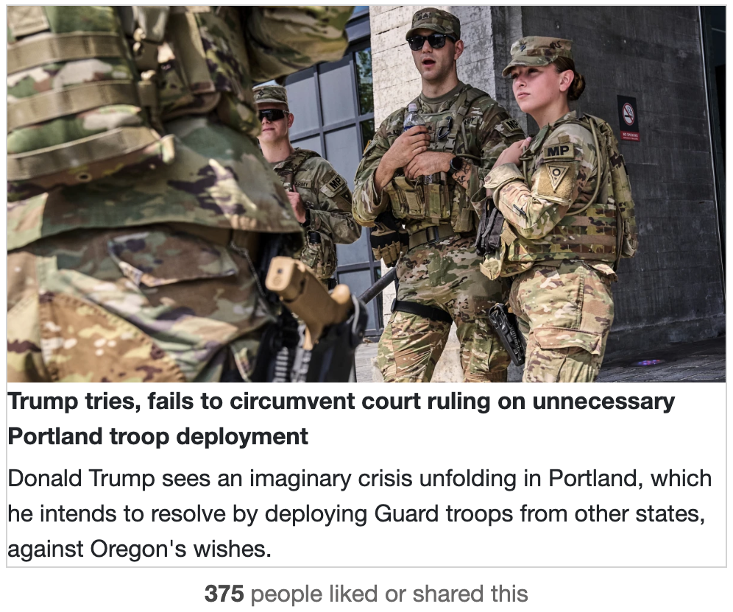
Hard for humans to identity
Notes:
This article comes from Msnbc, a mainstream source.

Slide 58
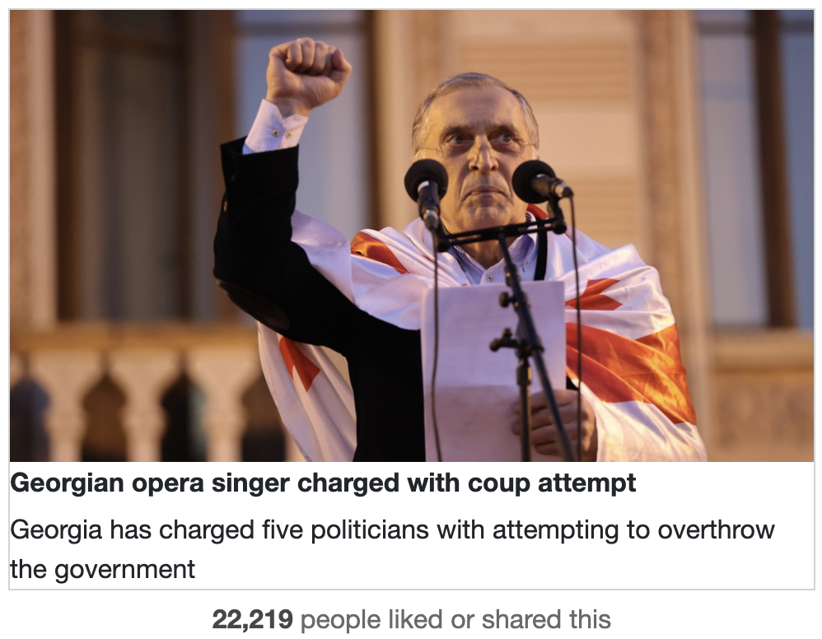
Hard for humans to identity
Notes:
This article comes from rt.com, a questionable source.

Slide 59
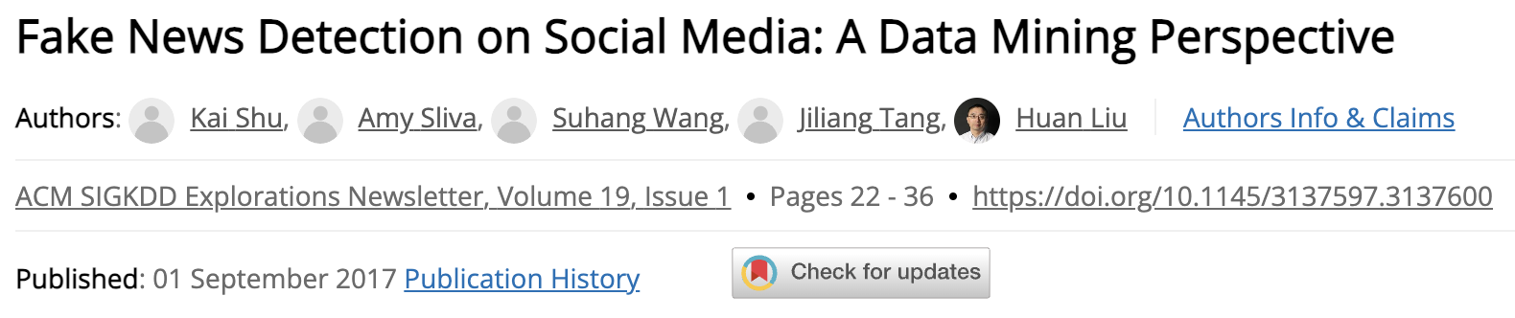
Fake news detection
A classification task (document-level or source-level)
High-quality data: https://www.snopes.com/fact-check/
Prediction using three sets of features:
Source-level
Content-level
Spreading pattern (network-level)

Slide 60
Characteristics of fake news
Fake news uses distinct linguistic features for virality.
Examples: “NEVER Trust This Candidate!”.
Stylistic and Syntactic: Sensational headlines, high adjective ratios, and all-caps usage (e.g., clickbait patterns in BuzzFeed).
Psycholinguistic: Negative emotions (anger, fear) and persuasive language, often detected via LIWC tools (e.g., higher negation).
Readability: Simpler language, lower Flesch-Kincaid scores, and repetitive structures for broad appeal and sensational tone.
Lexical/Semantic: Low vocabulary richness and emotional words.
Most of these features can be computed with Python!

Slide 61
Bot detection
Social media platforms and bots amplify the spread of fake news via algorithms prioritizing engagement.
Construct linguistic features on aggregated posts.
Key linguistic characteristics associated with bots:
Bots display uniform sentiment with low polarity and high consistency; with low complexity in emoji usage.
Bots show low emotional diversity, amplifying negative emotions like anger and anxiety in polarizing topics.
Bots underuse hedge words, showing higher certainty.
Bots exhibit low lexical diversity, high repetition.
Posts use uniform tweet lengths.

Slide 62
Course note
Group project
Can study any Q using any dataset from this class.
Contribution statement is required in final report.
No free rider!
Predictive Analysis next week
Regression / classification models
Model performance & evaluation
Research Design the week after
Questions?

